Slide 1
The visual interpretation of decision trees
(How to lead a fulfilling life by being dissatisfied)
Terence Parr University of San Francisco
Work done with Prince Grover
manifold.ai

Slide 2
Topics
How regression and classification decision trees work
Visualizing key elements of decision trees
Implementation notes
How to lead a fulfilling life by being dissatisfied

Slide 3
Decision trees

Slide 4
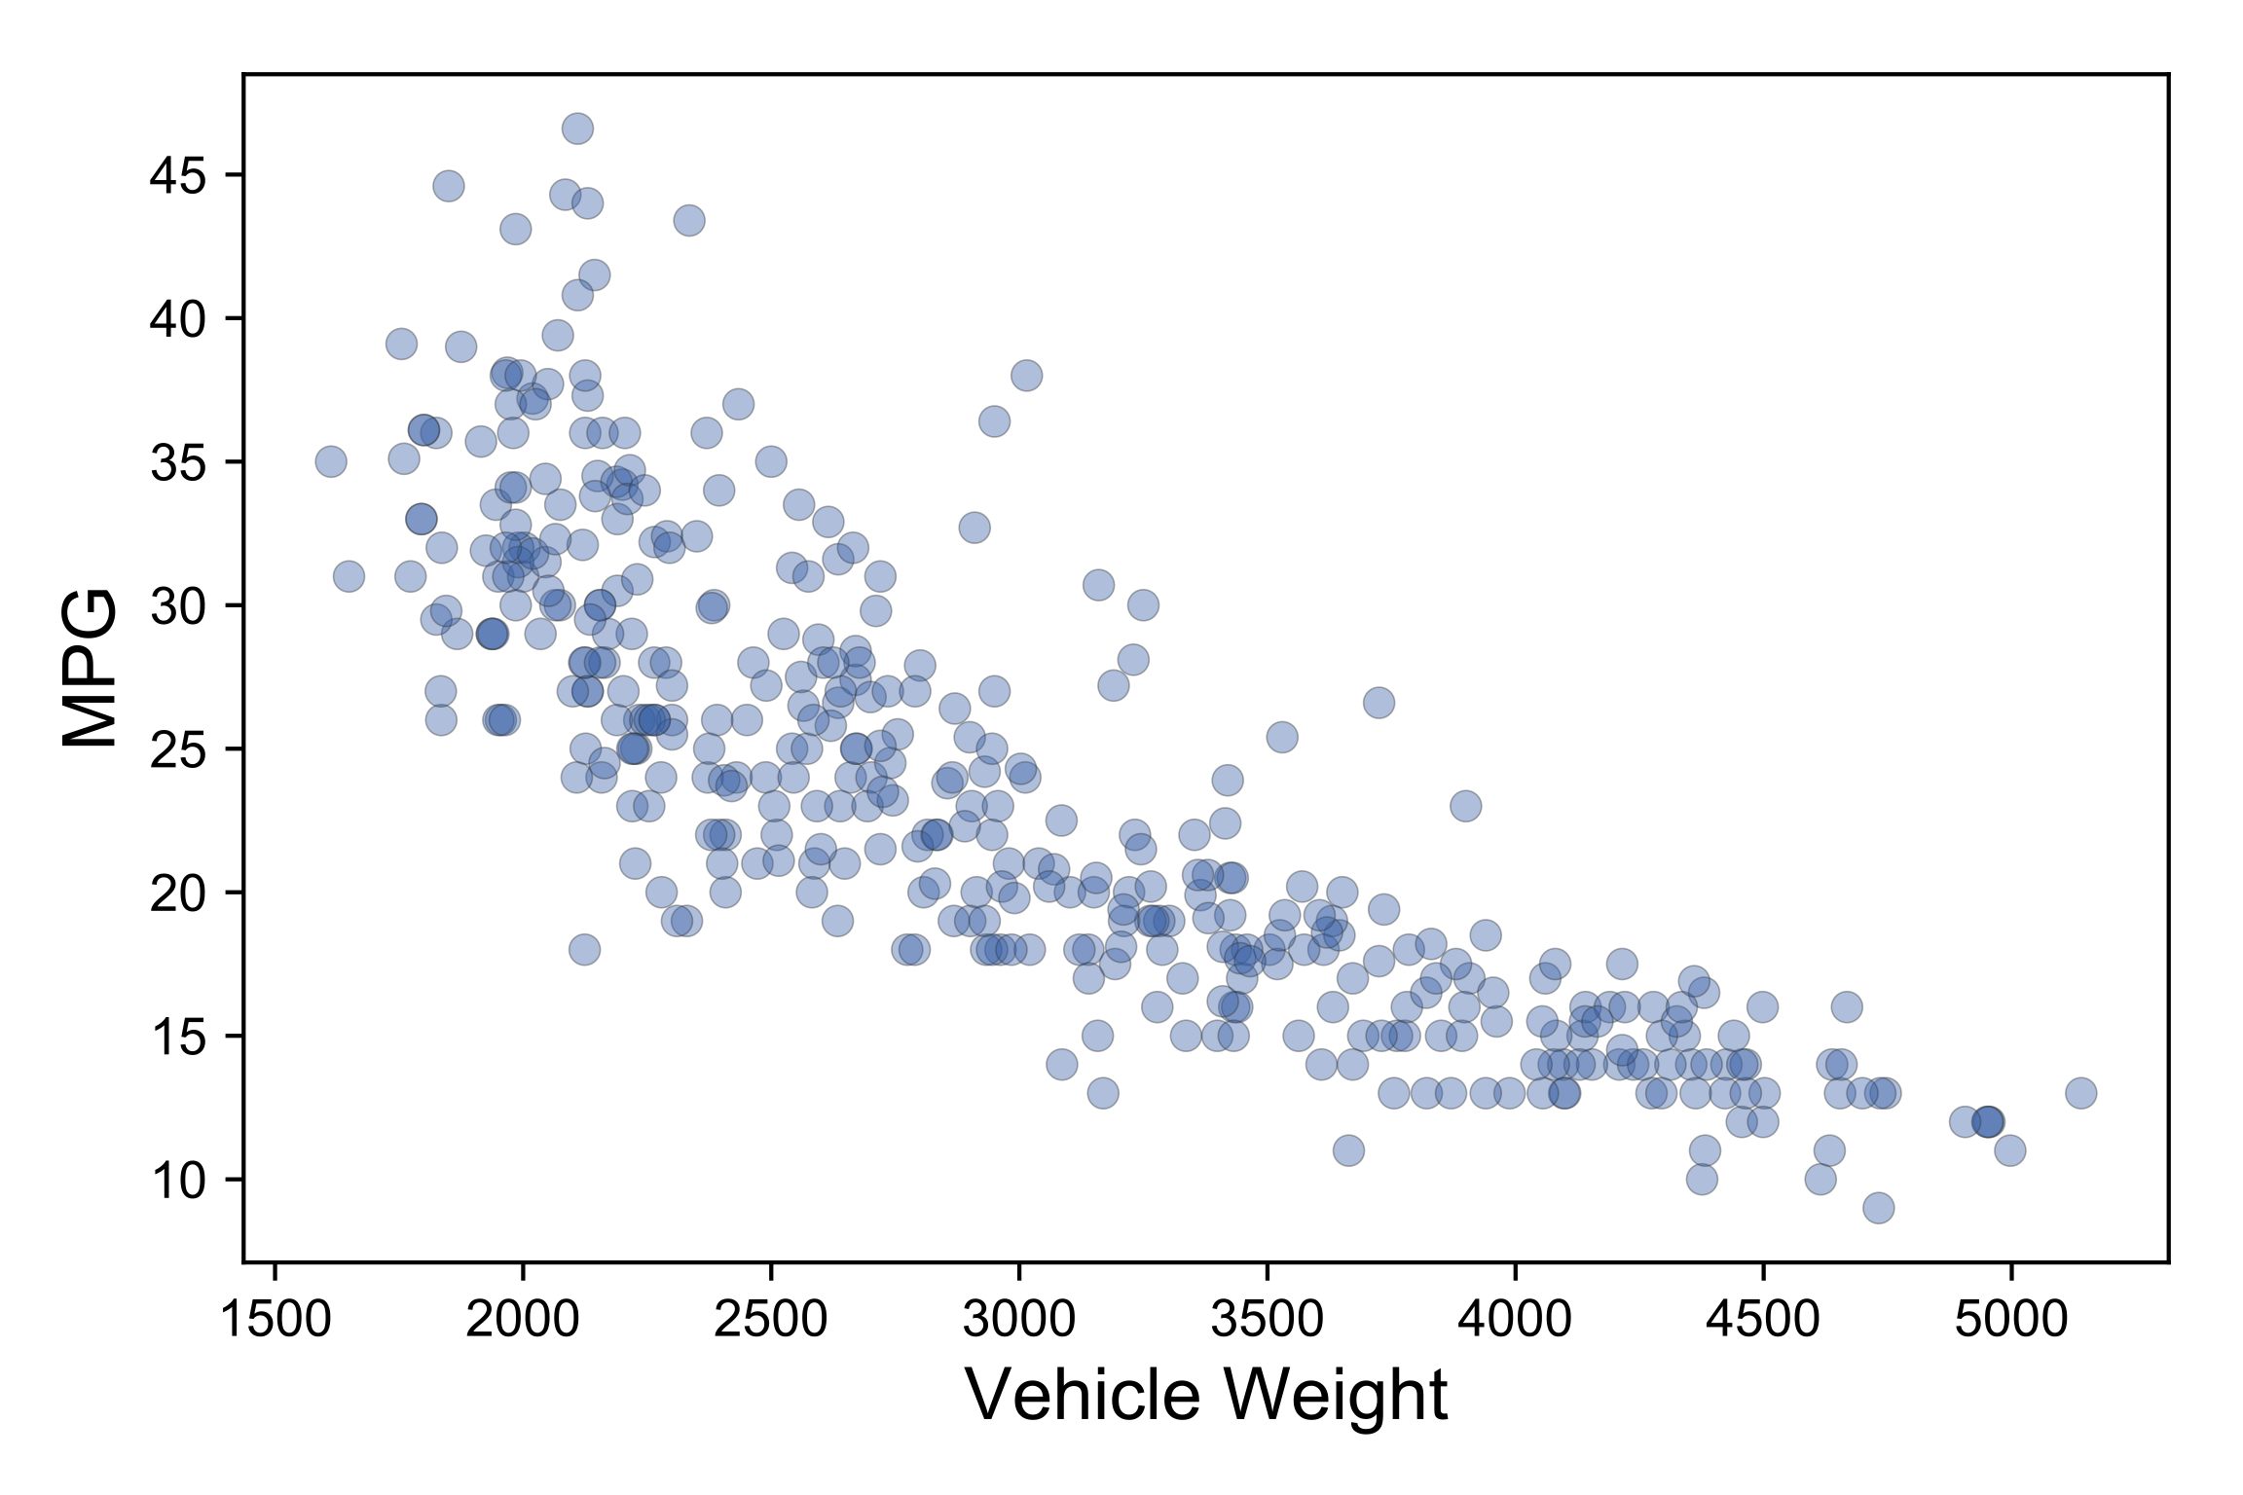
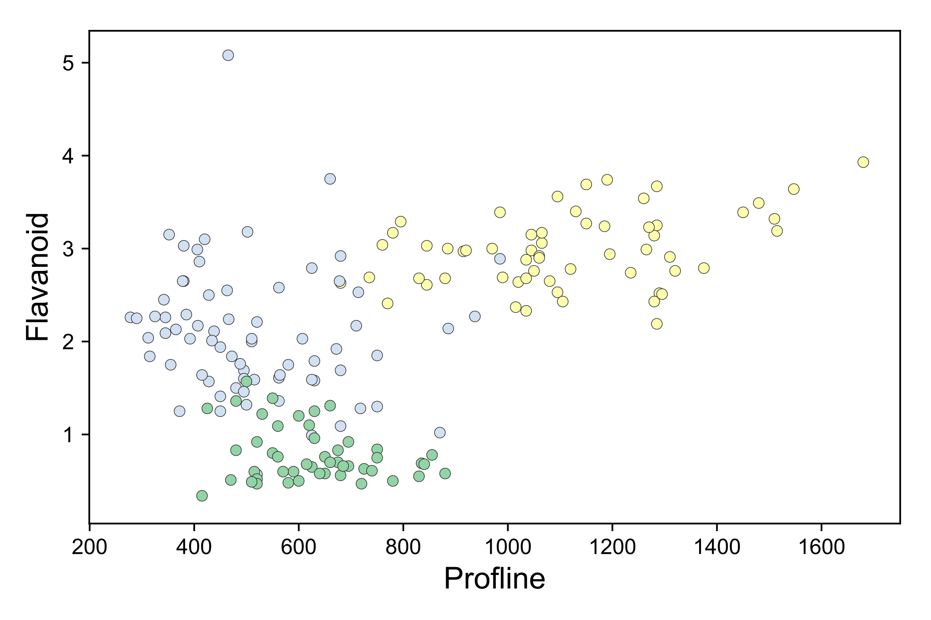
Regression versus classification
Regressors draw through data
Classifiers draw between data clusters

Slide 5
Different models have different surfaces
The model is just the decision surface(s), not the training data

Slide 6
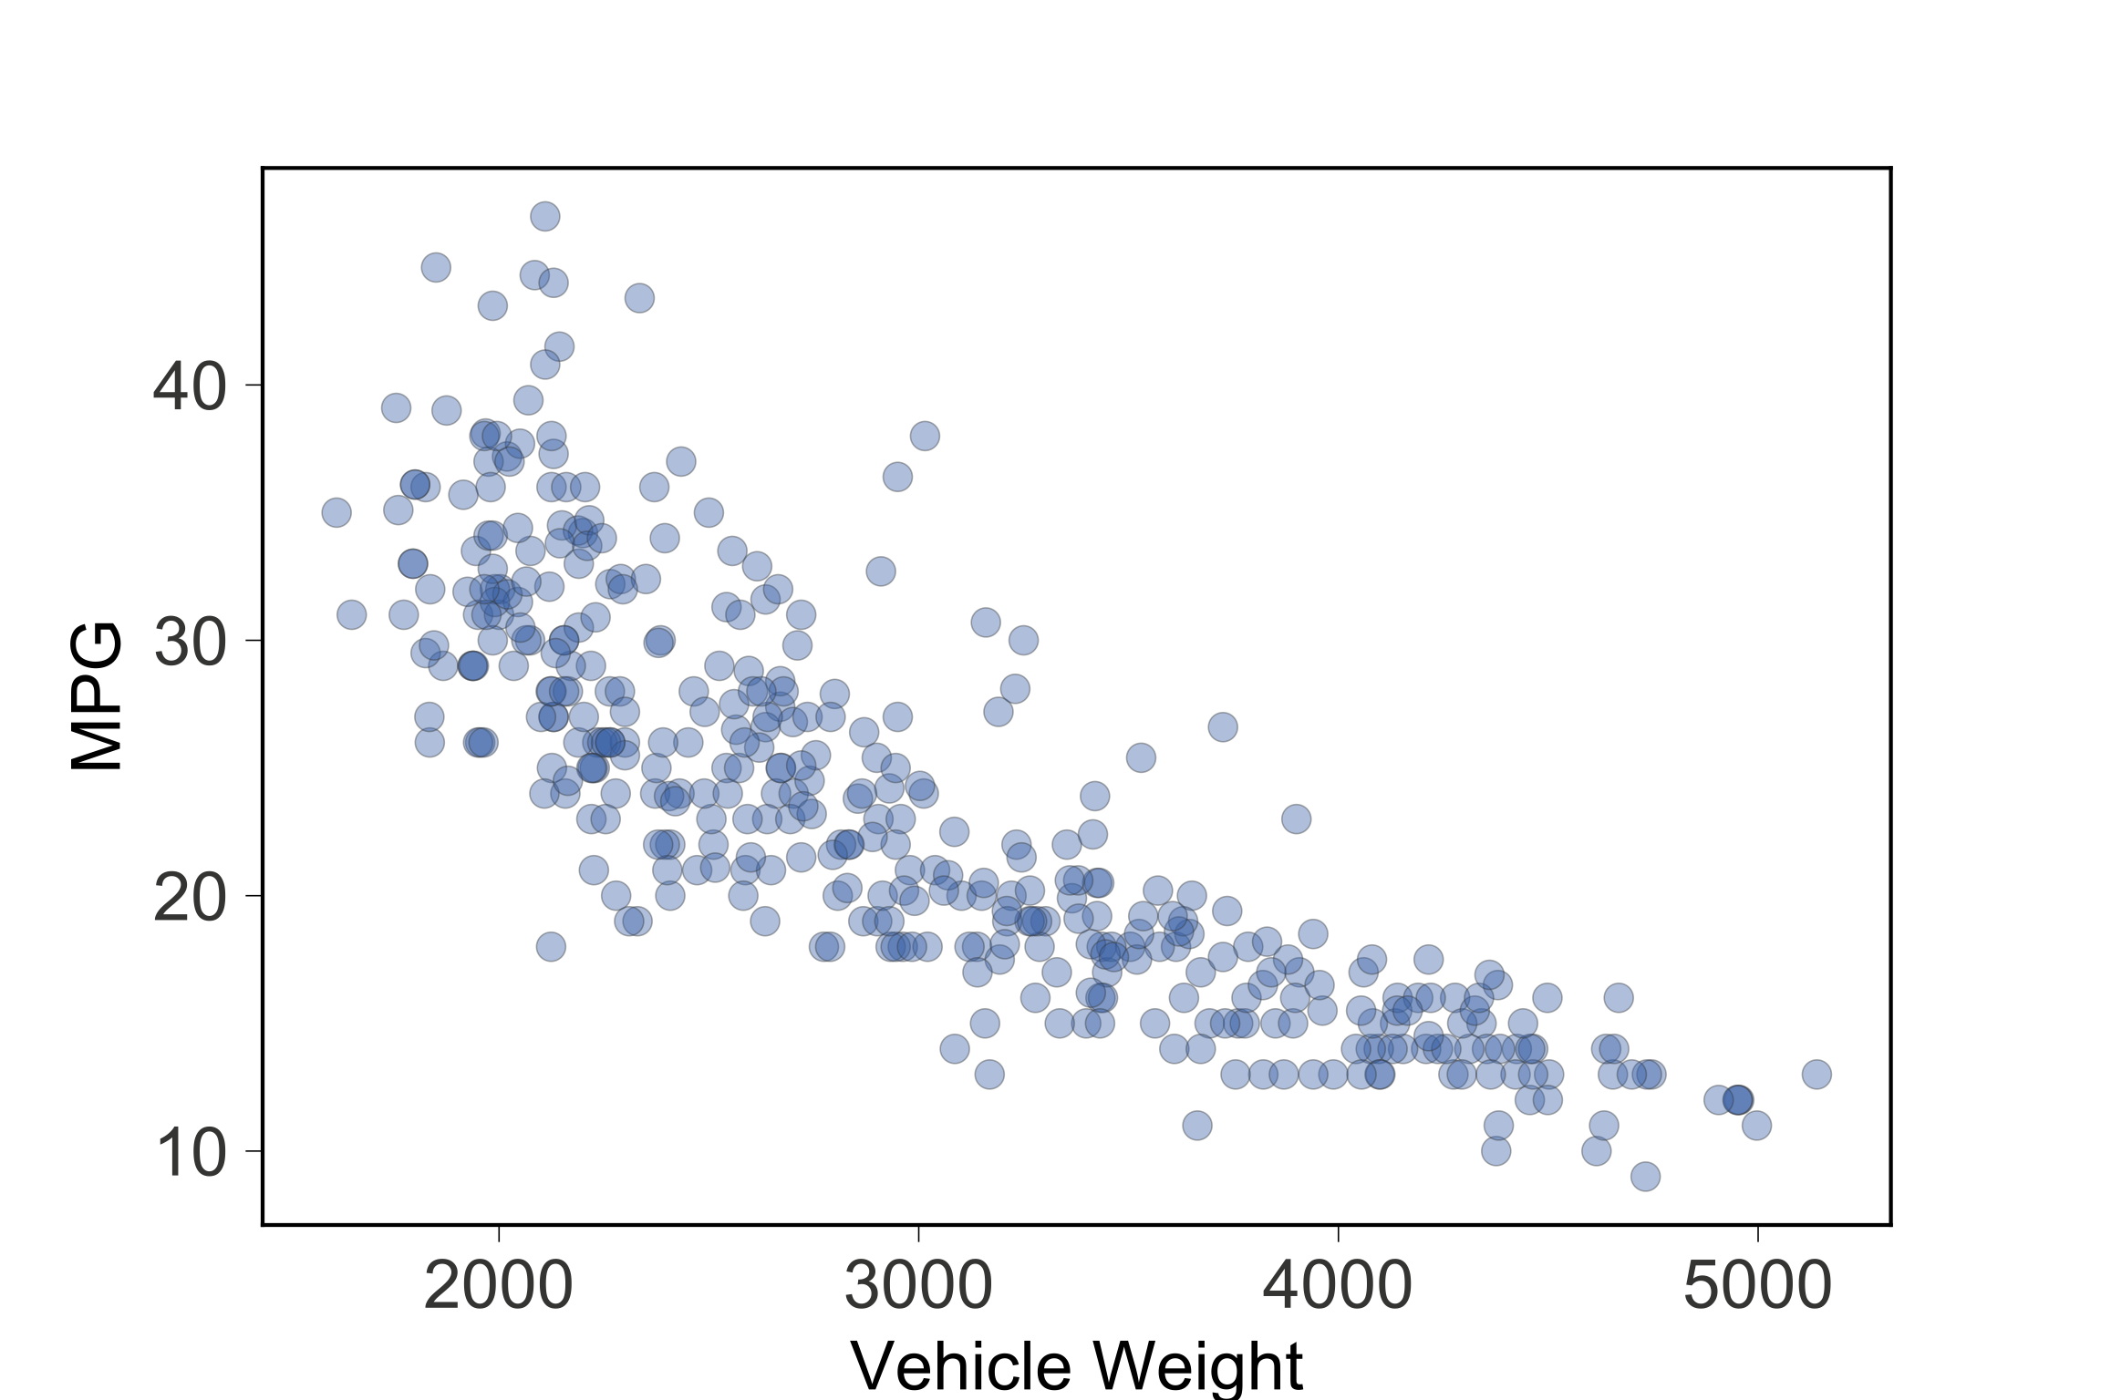
Let’s invent a simple regressor
Predict MPG
from weight
Predict a single
constant for
entire range
(the mean)

Slide 7
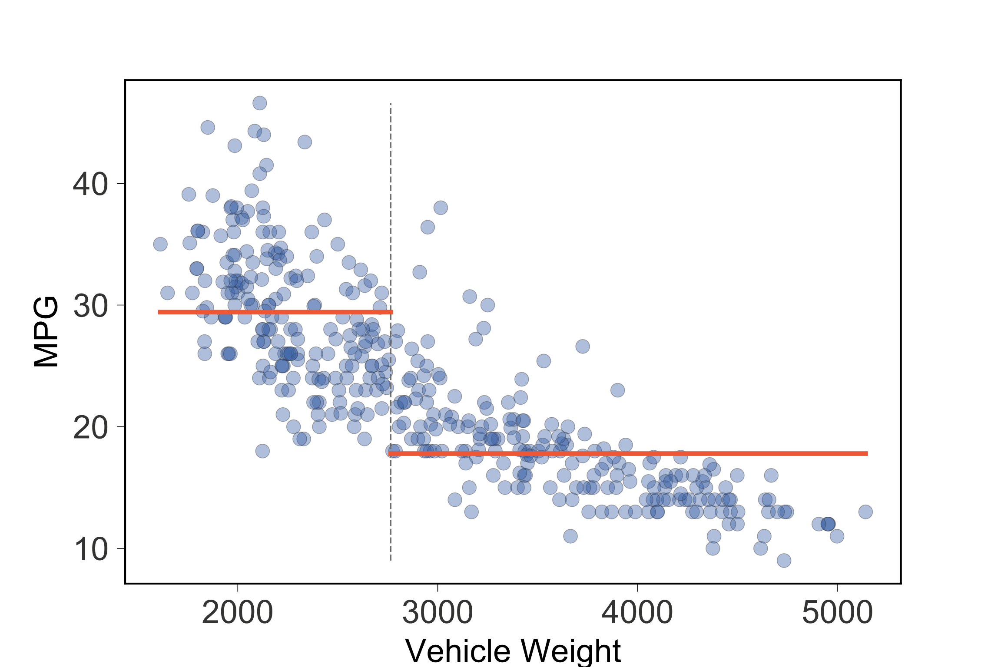
Improve by splitting into two regions
Predict mean
of training values
in each region
s1

Slide 8
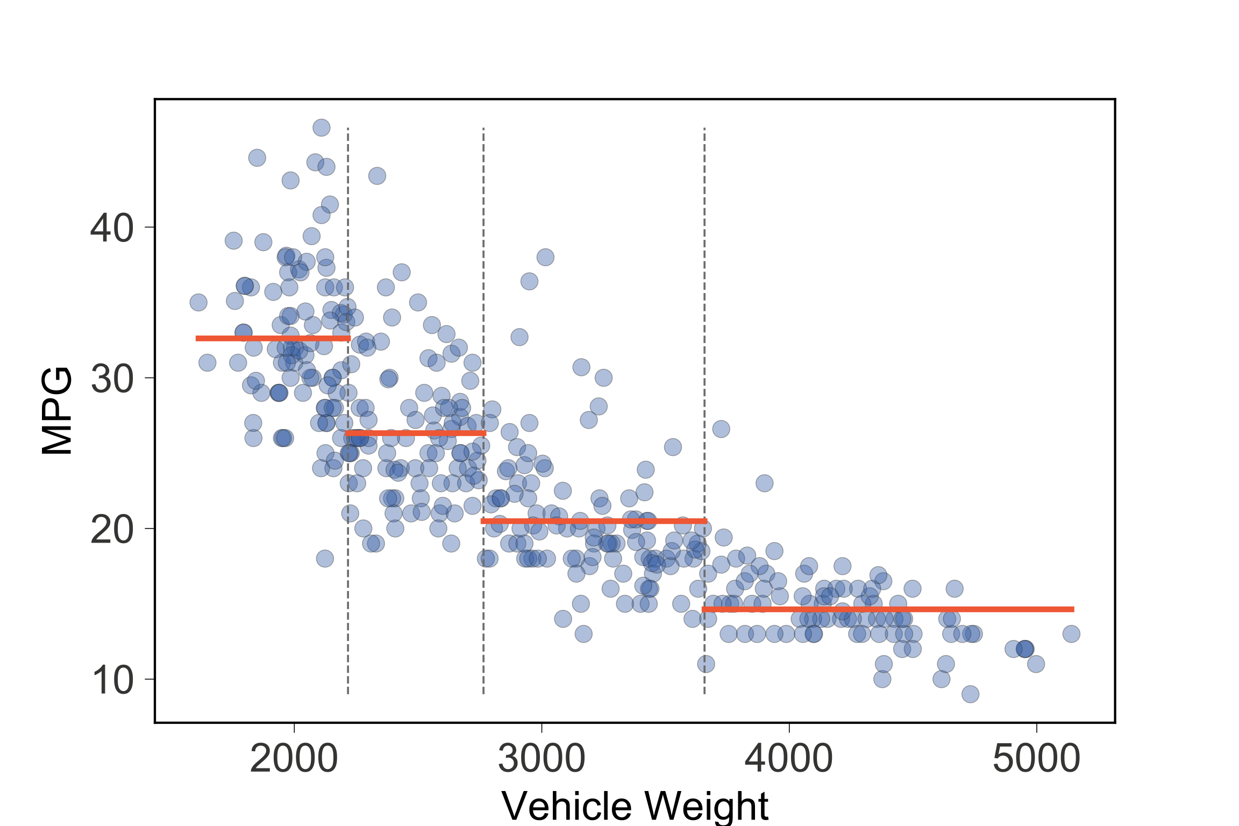
Improve by splitting into four regions
Technique:
Split into regions
of similar values
Split s1 stays,
recursively split
left/right to get
splits s2, s3
Kinda like binary
search
s2
s1
s3

Slide 9
Model implementation
Identify regions: test in split order
if x<s1 and x<s2: predict 32.6
if x<s1 and x>=s2: predict 26.3
if x>=s1 and x<s3: predict 20.5
if x>=s1 and x>=s3: predict 14.6
s2
s1
s3
Training looks for split point in region of
feature space that gives subregions with
less variance among target values

Slide 10
Factor split comparisons for efficiency
s2
s1
s3
if x<s1:
if x<s2: predict 32.6
else: predict 26.3
else:
if x<s3: predict 20.5
else: predict 14.6

Slide 11
Represent nested conditionals as regression decision tree
s1
s2
s1
s3
<
>=
s2
s3
<
>=
<
>=
32.6
26.3
20.5
14.6
Internal nodes test features
Leaves predict region mean

Slide 12
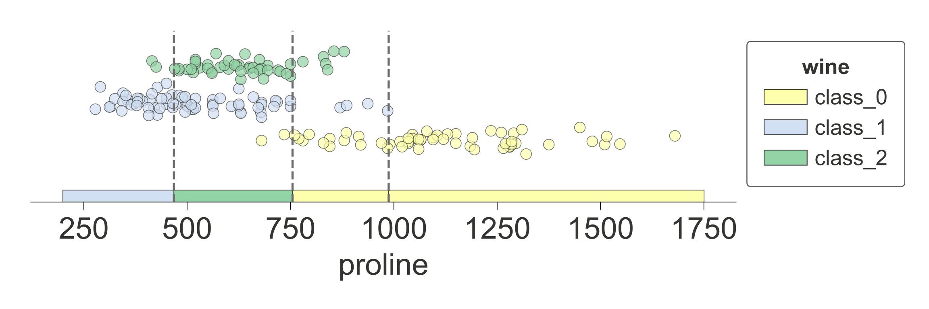
Classifiers split feature space too
Predict wine
from proline
s2
s1
s3
s1
<
>=
s2
s3
<
>=
<
>=
Internal decision nodes test features just like regressor trees
Leaves predict most common target category (mode) not mean

Slide 13
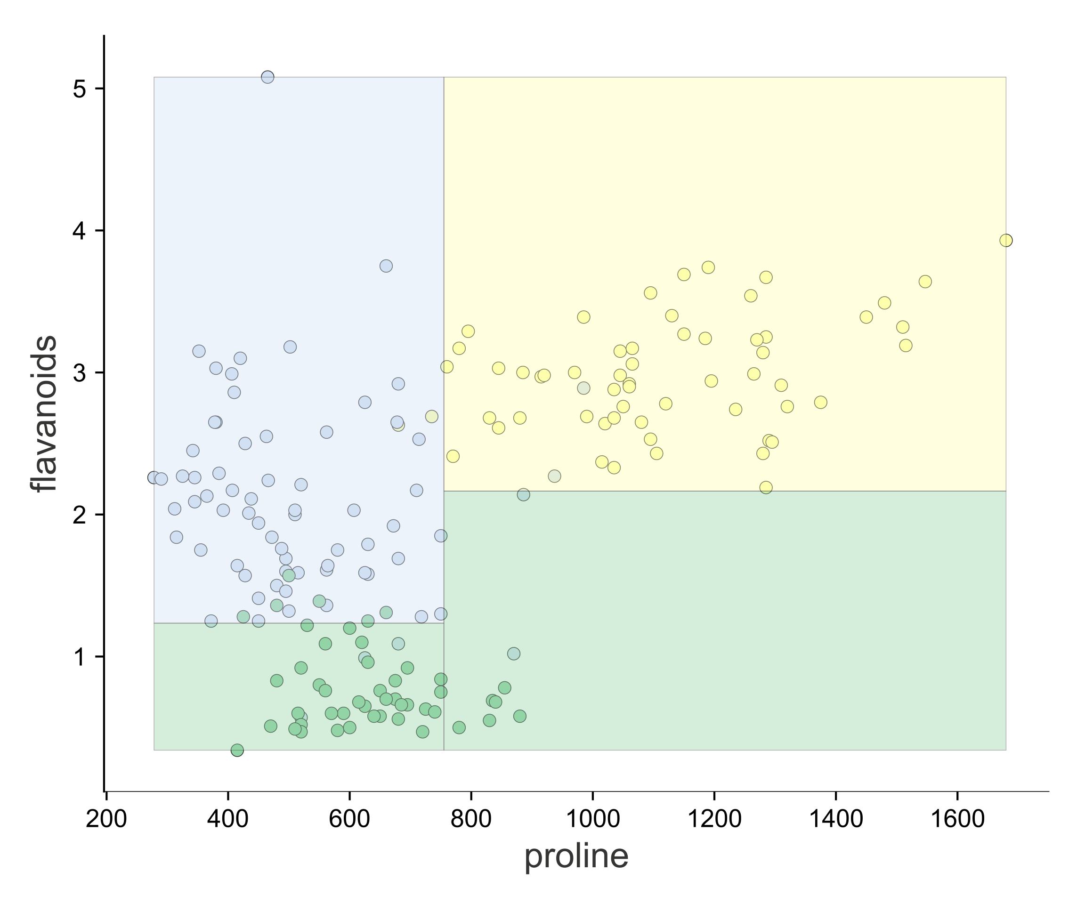
Improve predictions: Use 2 features and split 2D feature space into regions
x1
<
>=
y1
y2
y2
<
>=
<
>=
y1
Training looks for (feature, split point)
combo giving more pure subregions.
x1
Decision nodes compare single
feature value to split point

Slide 14
We can also split regressor 2D feature space into regions to improve accuracy
<insert awesome 3D visualization here>

Slide 15
Visualizing the key elements

Slide 16
1D feature space vs sklearn regressor tree

Slide 17
New dtreeviz decision tree

Slide 18
2D feature space vs sklearn decision tree

Slide 19
New dtreeviz decision tree

Slide 20
New dtreeviz decision tree (strip plot nodes)

Slide 21
Test vector interpretation

Slide 22
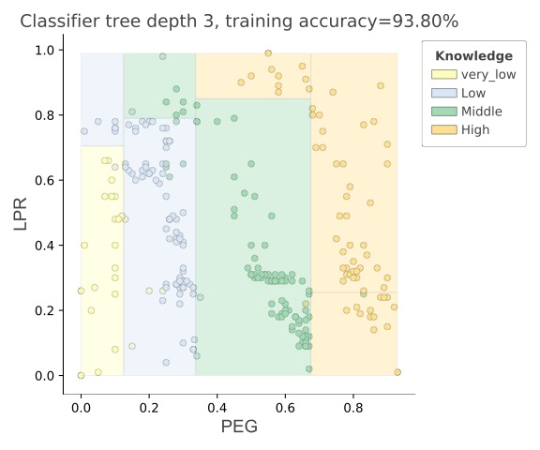
1D, 2D classifier feature space

Slide 23
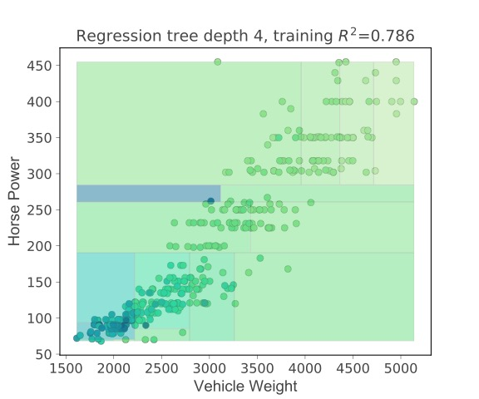
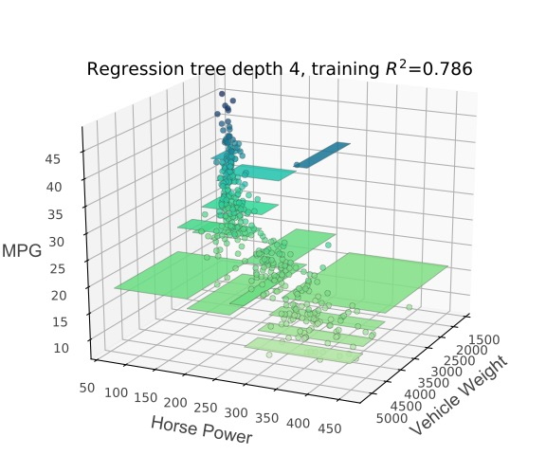
2D regressor feature space (heatmap, 3D)

Slide 24
Plain layout for large trees

Slide 25
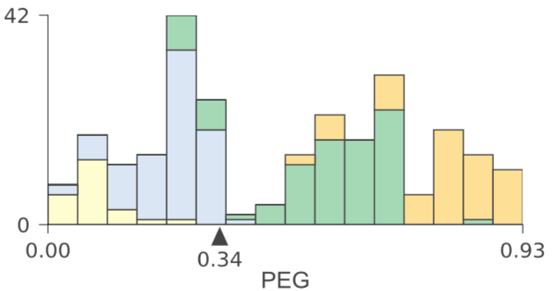
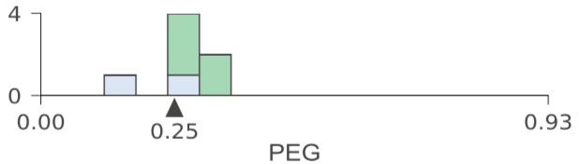
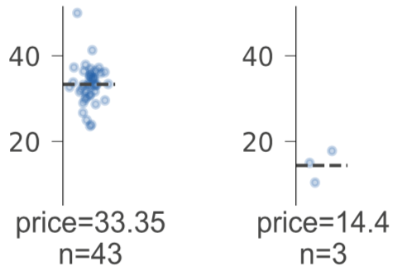
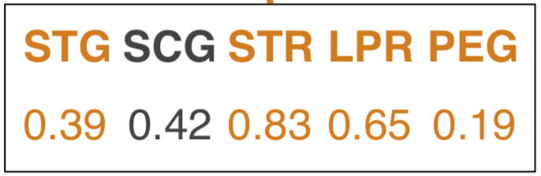
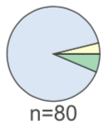
Details matter
Handpicked colors
Gray not black text/lines
Hairlines
Outlines of bars in barchart
Histos shrink
with sample size
Target axes show
same range
Highlight features
Used in test vector
Pie charts shrink
(nonlinearly)
with sample size

Slide 26
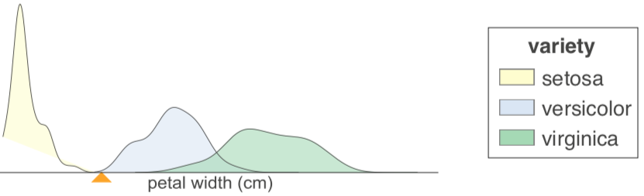
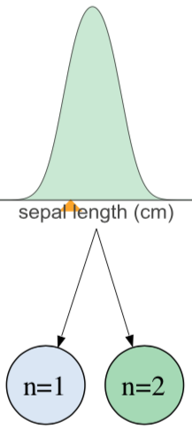
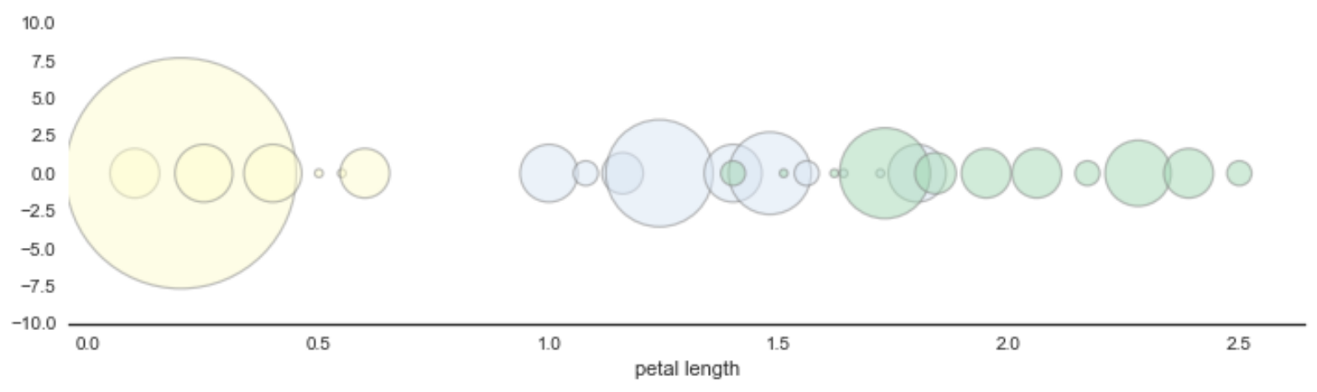
What we tried and rejected
Kernel density estimates (smooth histograms)
Bubble charts

Slide 27
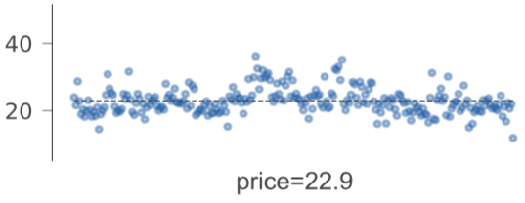
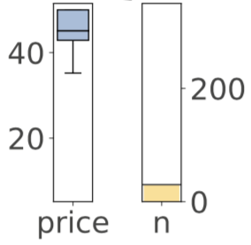
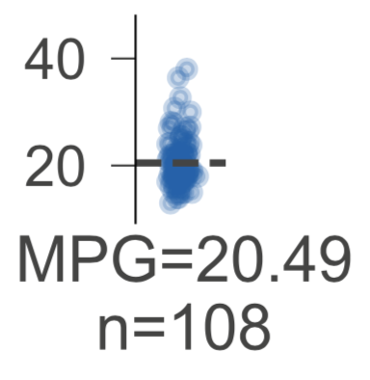
Tried various regression leaf types
Settled on strip plot

Slide 28
Implementation overview
We used matplotlib to generate images for decision, leaf nodes
Combined nodes into a tree using graphviz
Used HTML labels extensively in the graphviz for layout, fonts
Single biggest headache: convincing all to produce high-quality vector graphics (SVG)
Defined ShadowDecTree class to wrap sklearn trees

Slide 29
Generating high-quality graphics (SVG)
Want scalable graphics like PDF or SVG, not PNG, GIF, JPG
Import .svg or .pdf into graphviz? Nope.
Many hours later, discovered magic incantation for graphviz
Needed width/height of image; gotta parse SVG now
Graphviz generates SVG that references other SVGs
Wrote manual SVG image embedding tool to get single meta-SVG file
Uh oh. Graphviz doesn’t handle fonts correctly with SVG output
Generate PDF then run pdf2svg tool to convert PDF to SVG
Ah, but –Tsvg:cairo graphviz option does get fonts right
Switch code to straight SVG generation
Final insult: Jupyter notebook doesn’t show those SVG correctly

Slide 30
How to lead a fulfilling life by being dissatisfied

Slide 31
Be dissatisfied
Be offended by poor software and unsatisfying results
Crave beauty and quality
Quality must be baked in
Don’t put lipstick on a pig
Make the world a better place for others as you move along
Obsess about the details
Varying graph height, colors, box outlines, 3D plots, ...
Warning:
Dissatisfied personalities are annoying to those in the “blast radius”
Can send you off on tangents
But, your dissatisfaction is a win for everyone else

Slide 32
Be tenacious
Never let the computer win
Each loss would sap your confidence
Might require extraordinary lengths to solve
Lack of confidence leads to acceptance of status quo
“Why program by hand in five days, what you can spend five 30 years of your life automating?” -- parrt on ANTLR
Implementation of dtreeviz required pathological tenacity

Slide 33
Be courageous
Slap your code up on github, push to pypi, ship it!
Write articles or blog entries
Otherwise, you’re not helping the programming community
Building code and writing articles exposes holes in your understanding; holes become chasms as you try to explain
Face that fear; can’t improve unless you identify weaknesses
Students: these artifacts get you the job
You might think you don’t know anything (true at beginning)
Start with simple libraries or blogs, then reach
Practice expanding your abilities

Slide 34
Be a finisher
Constant tension between perfectionism and finishing projects
Details matter but must still ship it
Go off on tangents to solve subproblems but always return to finish the original problem
Make completion a key personality parameter to optimize
I know researchers with just unpolished, unpublished projects
How do you want to be measured?

Slide 35
How to contribute and make a difference
Look for the pain
Look for a hole in the market
Erase the pain with reusable and general code
Learn tactics from existing successful projects:
good name
website with domain devoted to project
useful doc
API design is hard; think hard about it
focus on conceptual integrity, consistent style
use social media to your advantage

Slide 36
“The reasonable [wo]man adapts [her|him]self to the world: the unreasonable one persists in trying to adapt the world to [her|him]self. Therefore all progress depends on the unreasonable [wo]man.”
― George Bernard Shaw

Slide 37
Resources
Decision tree visualization article: https://explained.ai/decision-tree-viz/index.html
My website for deep explanations of AI-related stuff: https://explained.ai
fast.ai's Introduction to Machine Learning for Coders MOOC: https://course.fast.ai/ml
U of San Francisco’s MS Data Science program: https://www.usfca.edu/arts-sciences/graduate-programs/data-science
https://matplotlib.org/
http://graphviz.org/

